Slide 1
Service announcement (call for action)

Slide 2

ML is more fun when you use your own dataset

Slide 3
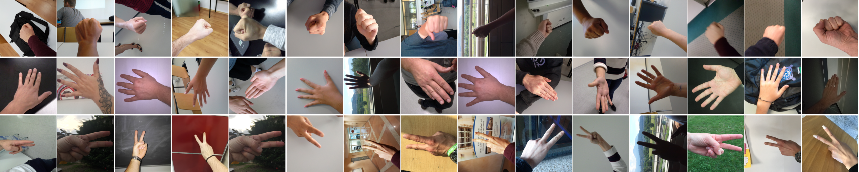
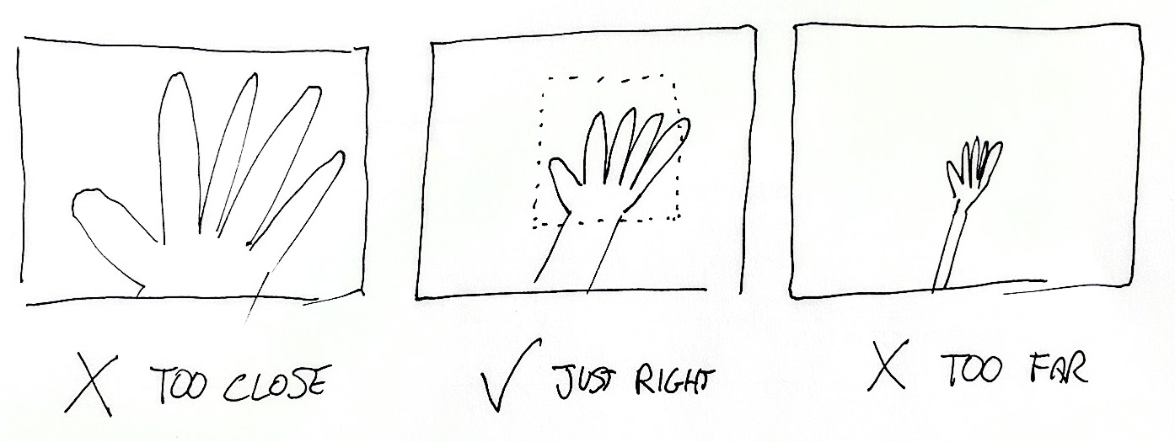
Let’s acquire a rock-paper-scissors image dataset!
We want to process images like this:
Rock
Paper
Scissors

Slide 4
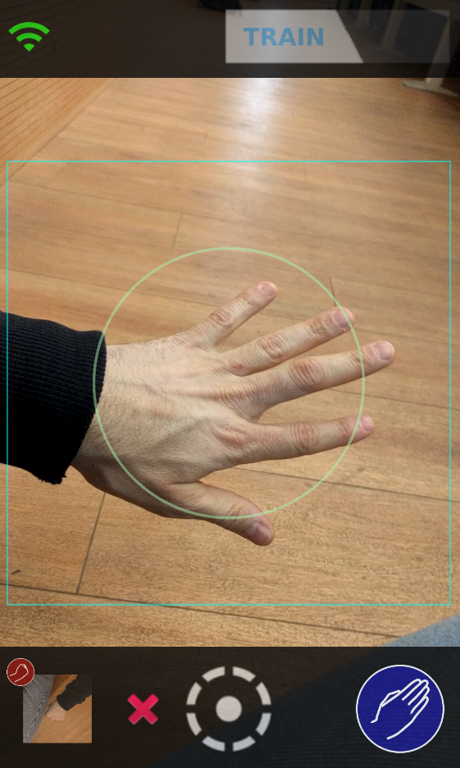
Try our app
http://rps.idsia.ch/rps
Data will be public:
Keep the data clean
Don’t upload personal identifying info (faces, documents)
Don’t hack our server

Slide 5
Connectivity
Only use training mode (i.e. dataset acquisition)
Frame the whole hand within the circle (roughly)
Last uploaded image & class (you can delete it with x)
Click to change the current class
Shoot & upload using the current class

Slide 6


